Slide 1


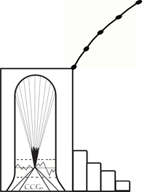
Keep
Jamaica Intact
NYS Independent redistricting commission hearing 11-17-2021 3:00 PM
Presented by:
Verda h. olayinka, cultural consultant
VerdaOlayinka@gmail.com

Slide 2

KEEP JAMAICA IN TACT
St. Albans to be split North of Merrick Blvd.
Hollis merges bet. Queens Village & Cambria Heights.
Springfield Gardens disappears and is split into 5 Villages.
Rosedale merged into Nassau County

Slide 3
Keep Jamaica In Tact
Goal: Not to Sacrifice Community Interests
Business Development, Housing, Sr. Centers, Community
Centers, Job Training & Career Development, Day Care Centers

Slide 4
Gerrymandering
Packing
Cracking
Hijacking
Kidnapping
Voters of one type in a single district
Spreading Voters of one type over many districts;
Separate incumbent candidate from own constituents;
Causing 2 incumbents in same district to run against each other

Slide 5
Congress & court requirements
Each District must be equal in population.
There must be an equal opportunity for minorities to elect the candidate of their choice.

Slide 6
Geometric shape
Contorted Boundaries -- Squiggly Boundaries are less compact. (CRACKING)
Dispersion – A district with pieces sticking out farther from the District’s Center are less compact. Example: Jamaica Revitalization District
Housing Patterns – More meaningful when the population is densely packed.

Slide 7
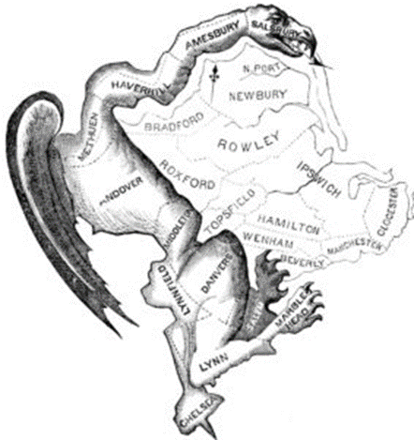
Jamaica cracking
ASSEMBLY DISTRICTS IN CONGRESSIONAL DISTRICT 5
MERGE VILLAGES VIA CONTORTED BOUNDARIES
Shaped like letters “L” (see pic) “J” even “K”

Slide 8
Jamaica cracking - Proposed examples
St. Albans to be split North of Merrick Boulevard
Hollis merges between Queens Village and Cambria Heights
Springfield Gardens disappears and split into 5 Villages
Rosedale merged into Nassau County

Slide 9
ALL Assembly districts in Jamaica:
Collective concern
ARE HEAVILY WEIGHTED on the North TOWARDS HILLSIDE AVENUE - THE SOURCE OF JAMAICA REVITALIZATION – LIMITING OPPORTUNITIES FOR
Voters in Southern Congressional District 5
Parts or All of Assembly Districts 22, 29, 24, 33, and 32

Slide 10
Jamaica negatively impacted
Voters in Jamaica Downtown, York College,
  St. Albans, Hollis, Cambria Heights, Springfield Gardens, Laurelton, Rosedale…
No longer have a single State Assembly Representative who can speak to our interests and needs;
Hence, we experience watered down representation;

Slide 11
A dedicated state assembly representative for voters in:
St. Albans, Hollis, Cambria Heights, Springfield Gardens, Laurelton and Rosedale will:
Advocate for us to Restructure Mortgages for Foreclosures and Pre-Foreclosures;
Re-configure equations by Banks and Finance Companies for Refinancing for Home Repairs and improvements;
Advocate for Employment in Queens & Manhattan qualified by Education and Experience;
  NOT DISQUALIFIED BY RACE and / or GEOGRAPHIC LOCATION

Slide 12
A dedicated state assembly representative for voters in Jamaica would…
Re-Configure population requirements for equal representation in the process of:
Combining the Southern Appendages
Creating real Contiguous Villages of St. Albans, Hollis, Cambria Heights, Springfield Gardens, Laurelton, and Rosedale
  Linked to York College and the “Downtown” Jamaica Revitalization District;

Slide 13
A dedicated state assembly representative for voters would be committed to:
Fostering Opportunities for Cross-Cultural Fertilization vs. Competitive Dysfunction between the Multicultural Immigrant Populations and the Descendants of Kemet (Africa) residing in Jamaica;
Debunking the False Media Representation of Crime and Social Degradation promoted in various social circles about our people, which needs to be rebooted;
  Because crime has declined since 1995 and decreased steadily to the present.

Slide 14
A dedicated state assembly representative for voters in Jamaica would be committed to:
Recognizing the fact that 48% of Adults in Jamaica have Some College or Higher
  Increase quality jobs and small business support.
  A Dedicated State Representative would include our voters in establishing a working group with local workforce providers, employers, and local academic institutions to identify opportunities to provide stronger, industry-linked skills training and workforce development.
Disputing the “ghetto” image in the minds of those who support gentrification in the Greater Jamaica Community.

Slide 15
Solutions for voters in congressional district 5
Create an Authentic Assembly District in the Jamaica geographic area by combining real contiguous Villages of St. Albans, Hollis, Cambria Heights, Springfield Gardens, and Laurelton, and Rosedale.
Include Jamaica, York College – which connects Voters to opportunities promulgated by the Jamaica Revitalization Initiative Strategic Investment Plan.
Allow Voters in Jamaica to benefit from the Multiple Federal Spending Streams currently being planned, developed and implemented by the Biden Administration.

Slide 16
NYS Independent redistricting commission -- thank you
For permitting me to present this case at the Public Hearing in the interest of Voters in the Jamaica Community so that we can Keep Jamaica Intact.
November 17, 2021
Verda Harris-Olayinka, Cultural Consultant
Cultural Consultants Group, LP
VerdaOlayinka@gmail.com

