Slide 1
Redistricting Hearing November 8th, 2021
By: David Duarte

Slide 2
Opportunities with Redistricting
Rationalize Districts at Congressional and State Levels
Draw districts in recognition of maintaining communities of interest fairly represented in a continuous format – not just geographic contiguity
Enables districts to be more cohesive economically and socially – for more effective representation of common needs and services
I share a Westchester focused set of approaches:
Recognizes Westchester’s unique and diversity of economic development.
Acknowledges Westchester’s distinct infrastructure pattern
Incorporates Westchester’s rich socio-economic diversity

Slide 3
Approaches to Redistricting
Why use Highways and Parkways as natural district borders?
Because Highways/Parkways connect and divide communities
Pro – Westchester’s North/South Parkway Orientation results in both economic activity and socialization patterns in a North/South manner
Con – Highways interrupt street grids – Westchester’s East/West continuity of economic and social integration is more limited versus the N/S axis.
Tests to Westchester’s N/S Orientation when drawing districts:
Street Grid Continuity –
Can one walk from one side of the district to the other – within reason?
Is an interstate or parkway the only mode of transportation to connect?
Other Natural Barriers/Connectors: Train Lines, Rivers

Slide 4
Application to Congressional Districts?
Support for Commision’s Bronx/Westchester East-West Border:
- Distinct property, income and sales tax regimes
Different School Funding mechanisms and Educational Infrastructure
Physical infrastructure: no subways, simplified interstate routes
Separate Sewer Infrastructure
100 year decision for Southern Westchester to not form part of NYC
Street Grid Continuity – (Recognize #’s may require carve-outs and –ins)
New Rochelle and Pelham do not have a continuous street grid with Bronx
Westchester / Bronx Continuous Street Grids include:
Riverdale, Wakefield / Woodlawn with Yonkers and Mount Vernon.

Slide 5
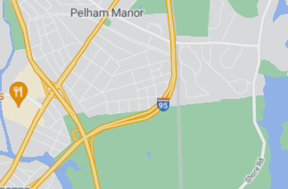
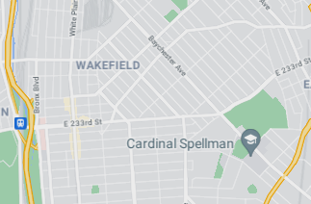
Westchester Bronx Street Grids - Visualized
New Rochelle and Pelham – Street Grid and Sidewalks have hard stop at the Bronx Boder
One cannot walk from one side of the district to another. Thus, though geogrphically contiguous, in practice, it could not form a contiguous district with the Bronx
Versus
Mount Vernon – Street Grid and Sidewalks are relatively continuous.
→ Even if intersections are not exact, one can walk from one side of the district to the other. Like Mount Vernon, Yonkers has a continuous street grid with the Bronx.

Slide 6
Carve-outs and Carve-ins for CD 16
Riverdale, Wakefield and Woodlawn neighborhoods are ideal to be carved out of Bronx to the Westchester side of CD 16 or vice-versa.
Why?
Pass Street Grid Test – continuous street grids
Follow North/South Orientation of physical infrastructure
Riverdale has Hudson Line Metro North Train Line, Route 9/9A and Saw Mill River Parkway / Henry Hudson Parkway connecting its neighborhoods
Wakefield and Woodlawn share Metro-North’s Harlem Line as well as Bronx River Parkway as connective infrastructure to Yonkers and Mount Vernon.

Slide 7
Incorporating North – South to CD 16/17
Westchester’s Communities are unique also by natural geography
The Hudson River towns and the Hudson River watershed result in unique challenges and opportunities such as:
Environmental – Pollution clean up, Brown Field investments as well as flooding
Infrastructure – Mario Cuomo Bridge, etc. More hills and different infrastructure needs
Economic Development – transit-oriented development includes Rockland County, NYC, White Plains, Amtrak stations, riverfront, culture, arts and an important tourism sector.
- Sound Shore and watershed are distinct from Rivertowns:
Environmental – Major flooding concerns (i.e. Hurricane Ida)
Infrastructure – (I-95 plus possible tunnel to Long Island?), Border with Connecticut
Transit-Oriented Development with connectivity to CT, White Plains and Manhattan (Grand Central and Penn Station) plus North East Corridor Amtrak

Slide 8
Proposed Congressional Map
CD 16 maintains Commission’s:
Southern Border with the Bronx
East-West orientation along Cross County Parkway in Southern Westchester
CD 16 pivots to then incorporate Sound Shore and the CT borderline
Follows Hutchinson River Parkway, I-95, I-684 and Metro-North New Haven Lines as economic and social connective infrastructure
Maintains Street Grid Continuity
CD 17 is drawn more as a Rivertown District, capturing both sides of the Hudson River.
Follows Route 9/9A, Saw Mill River Parkway, I-87, Sprain Brook/Taconic State Parkway, Bronx River Parkways and Metro-North Hudson and Harlem Lines as N/S connective infrastructure
Challenge: Street Grids interrupted by Hudson River partially mitigated by MC Bridge walkways, bus lines and some river boat connectivity

Slide 9
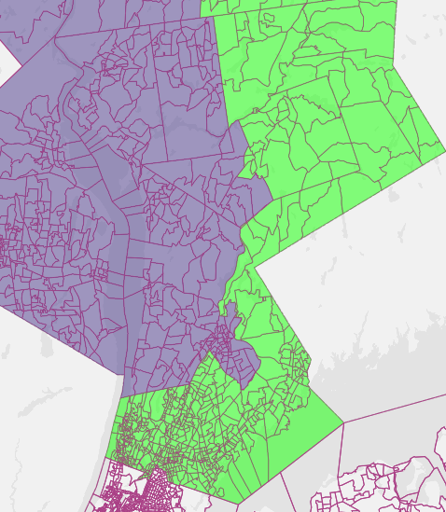
Sample Map: CD 16 / 17
Sample CD# | Estimated Population | Deviation
16 (Green) | 777,414 | 443
17 (Purple) | 776,976 | 5
Courtesy of davesredistricting.org

Slide 10
Westchester’s NYS Senate Maps
Westchester 2020 Census Population supports approximately 3.1 NYS Senate districts.
Westchester perspective: ~40k people in Westchester will be carved out to a non-Westchester NYS Senate district
Easiest Carve-outs: Bronx (South Border) or Putnam County (North)
Street Grid Test: Street Grid Continuity is best along Bronx border
Current Commission Maps would not meet the Street Grid Test because connective infrastructure does not support the range and extent of the East-West span of current NYS Senate districts.

Slide 11
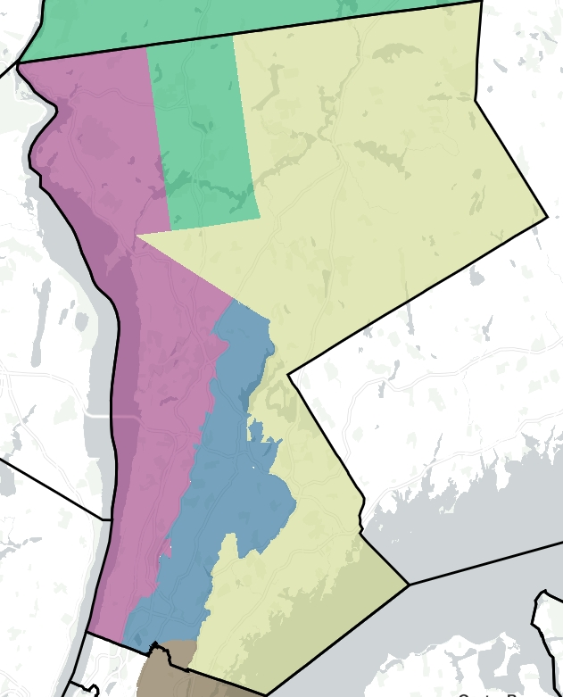
Proposed State Senate Maps
NYS Senate District | Color | Population | Deviation
35 | Purple | 319,195 | -1,459
36 | Yellow | 315,766 | -4,888
37 | Blue | 298,717 | -21,937
Courtesy of districtbuilder.org
This map is shared for illustrative purposes and is near completion.
Special Mention: Mount Vernon, south of the New Have Line tracks are carved out for a Bronx based border due to the ~40k residents in a non-Westchester border.
To address the deviation in #37, the district can be drawn North into New Castle or South – towards the Bronx border. Yorktown can be added to #36 to mitigate if New Castle is added to #37.

Slide 12
Westchester’s State Assembly Maps
Westchester 2020 Census Population supports approximately 7.5 NYS Assembly districts.
Westchester’s perspective: ~61k people in Westchester will be carved out to a non-Westchester NYS Assembly district
Easiest Carve-outs: Bronx (South Border) or Putnam County (North)
Street Grid Test: Street Grid Continuity is best along Bronx border Northern border with Putnam County
Current Commision Maps would not meet the Street Grid Test because the connective infrastructure does not support the range and extent of the East-West span of current NYS Assembly districts.

Slide 13
NYS Assembly Map Proposal (Rationale)
Follows North-South Infrastructure Orientation more strictly…
… it also keeps Mount Vernon in Westchester …
… avoiding a carve out to the Bronx … with more slender N/S districts.
7 NYS Assembly Districts are proposed in Westchester:
2 Rivertown Districts (from South to North):
Yonkers + Dobbs Ferry Riverfront (Saw Mill River Parkway is Eastern Border)
Rivertown North (Ardsley to Peekskill (N/S), SMRP border to East)
2 South Central Districts (From East to West):
East Central (In Between BRP and HRP – MV, Eastchester, Pelham and NR/Scarsdale)
West Central (In between SMRP and BRP (East Yonkers and East Greenburgh)
3 Connecticut Border Districts (From North to South):
North (North Castle and Mount Pleasant and northward)
Central Westchester (North of I-95/MNR New Haven Line and East of BRP)
Sound Shore (Defined by MNR New Haven Line, I-95)

Slide 14
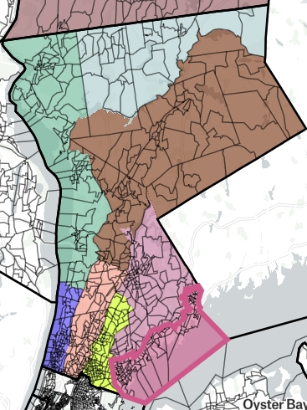
Proposed State Assembly Map (2/2)
NYS Assembly District | Color | Population | Deviation
89 (Yo-Gr-River) | Purple | 135,003 | +329
90 (Yo-Gr-East) | Peach | 135,045 | +371
88 (MV-Eastch) | Yellow | 135,377 | +703
93 (So. Shore) | Dark Pink | 136,737 | +2,063
87 (WP-Har) | Light Pink | 130,809 | -3,865
92 (Rivertowns) | Green | 137,629 | +2,955
91 (Cen. North) | Brown | 133,283 | -1,391
95 (N + Put Co.) | Light Green | 60,574 | n/a
Courtesy of districtbuilder.org

